Slide 1
Chapter 5
Cloud Infrastructure and Security Management
Dr.Mohammed Tawfik

Slide 2
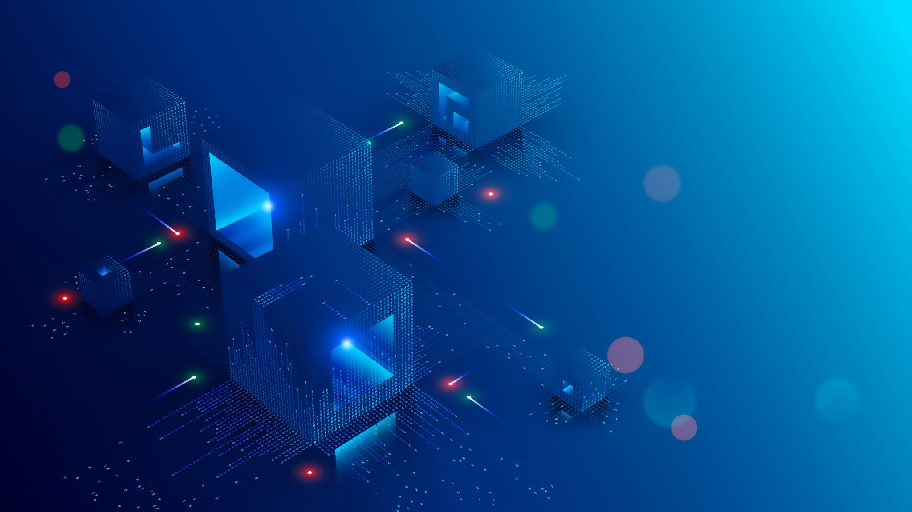
What is Cloud Infrastructure?
Definition Cloud infrastructure refers to the hardware and software components needed to support cloud computing services, including servers, storage, networking, and virtualization software.
Key Components
Physical Hardware: Servers, data centers, networking equipment
Virtualization Layer: Hypervisors and virtual machine management
Network Infrastructure: Internet connectivity, load balancers, CDNs
Management Software: Orchestration, monitoring, and automation tools
Service Models
Infrastructure as a Service (IaaS)
Platform as a Service (PaaS)
Software as a Service (SaaS)

Slide 3
Types of Cloud Infrastructure
Public Cloud
Owned and operated by third-party providers (AWS, Azure, Google Cloud)
Resources shared among multiple customers
Pay-as-you-go pricing model
Private Cloud
Dedicated infrastructure for single organization
Can be on-premises or hosted by third party
Greater control and security
Hybrid Cloud
Combination of public and private clouds
Data and applications can move between environments
Flexibility and optimization opportunities
Multi-Cloud
Using services from multiple cloud providers
Avoids vendor lock-in
Best-of-breed approach

Slide 4
Understanding Cloud Resources
Compute Resources
Virtual machines (VMs) and containers
CPU, memory, and processing power on-demand
Auto-scaling capabilities
Storage Resources
Object storage (files, images, videos)
Block storage (database storage)
File storage (shared file systems)
Network Resources
Virtual networks and subnets
Load balancers and firewalls
Content delivery networks (CDNs)
Database Resources
Managed database services
NoSQL and relational databases
Data warehousing solutions

Slide 5
Benefits of Cloud Infrastructure
Cost Efficiency Cloud infrastructure eliminates the need for large upfront investments in hardware and data centers. Organizations pay only for the resources they actually use, which significantly reduces operational costs and allows for better budget predictability.
Scalability and Flexibility One of the most significant advantages is the ability to scale resources instantly based on demand. Whether facing sudden traffic spikes or planning for business growth, cloud infrastructure adapts automatically to meet changing requirements.
Reliability and Global Reach Cloud providers offer high uptime guarantees through redundant systems and geographic distribution. This ensures business continuity and provides robust disaster recovery capabilities that would be expensive to implement independently.
Enhanced Security and Innovation Enterprise-grade security measures are built into cloud infrastructure, with regular updates and compliance certifications. Additionally, organizations gain immediate access to cutting-edge technologies, enabling faster innovation and shorter time-to-market for new services.

Slide 6
Cloud Resource Management and Monitorin
Resource Allocation Strategies Effective cloud resource management requires understanding workload patterns and implementing intelligent allocation strategies. This includes right-sizing instances, using auto-scaling groups, and implementing resource tagging for better organization and cost tracking.
Monitoring and Analytics Modern cloud platforms provide comprehensive monitoring tools that track performance metrics, resource utilization, and security events. These tools enable proactive problem detection and help organizations optimize their cloud investments through data-driven decisions.
Backup and Disaster Recovery Cloud infrastructure offers sophisticated backup and disaster recovery options, including automated backups, cross-region replication, and point-in-time recovery capabilities. Organizations should develop comprehensive backup strategies that align with their business continuity requirements.

Slide 7
Security Management Overview
Shared Responsibility Model for Security
Data Security
Securing Virtual Networks in the Cloud
Identity and Access Management (IAM)
Cloud Security Best Practices
Security Testing

Slide 8

Key Terminology
Encryption – the process of converting original data into a coded (unreadable) form using mathematical algorithms and keys
Plaintext – data before encryption
Ciphertext – data after encryption
Stateful Packet Inspection – is performed by firewall devices; they ensure that data packets that are received in response to internal requests are always permitted

Slide 9
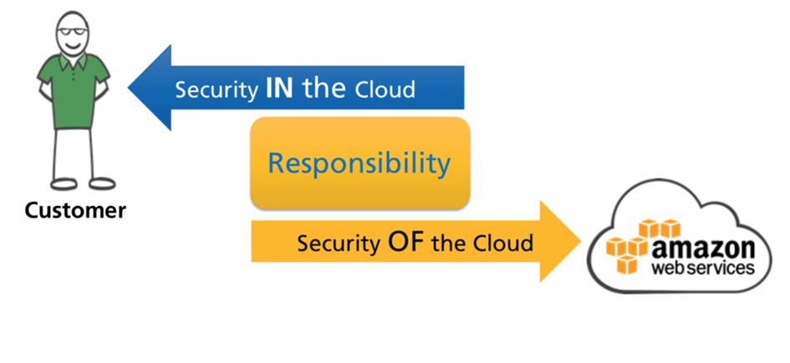
Security is a shared responsibility!
Source: AWS
There is a common misconception among employees, managers, and senior leaders of companies included. They believe that if the company adopts a public cloud, the responsibility for security of applications and data falls on the CSP.
Many real-world security incidents occur due to poor understanding of the shared security model.

Slide 10
Shared Responsibility Model for Security
It is vital to understand that security is a shared responsibility between two parties: the CSP and the cloud consumer.
The CSP is responsible for securing the cloud infrastructure (Regions, Zones, etc.) over which services are provisioned and achieving logical isolation between customer data. The consumer is always responsible for access management and data security. Many CSPs provide security tools and services, but the customer is responsible for configuring and using them based on their need.
Specific responsibilities vary by:
the cloud service provider (CSP)
type of service model (IaaS, PaaS, SaaS)
service offering (managed vs. unmanaged)
For e.g., in the AWS cloud platform, the Elastic Compute Cloud or EC2 service is an example of an unmanaged IaaS service. When a cloud customer launches an EC2 instance in the cloud (equivalent to a VM), they are responsible for installing, patching, and upgrading the OS atop the instance. However, a relational database or RDS instance is an example of a managed solution. Many of the administrative tasks such as performing backups and patching the software that powers the database is handled by AWS.

Slide 11
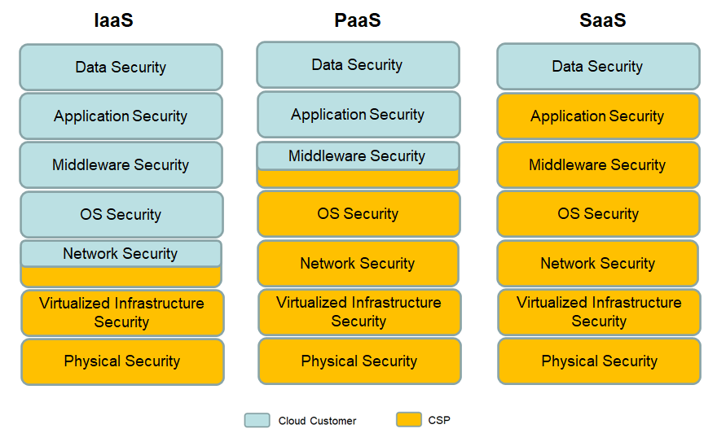
Original Source: Practical Cloud Security by Chris Dotson
The figure shows how the responsibility for security varies with the type of service model in use.
In the example of IaaS, you can see the responsibility for network security lies with both parties. The CSP secures the physical network but configuring the virtual network on top (implemented as Virtual Private Cloud or VPC) including trust zones and access to resources therein is the customer’s responsibility.
Notes:
Middleware includes databases, application servers, queueing systems.

Slide 12
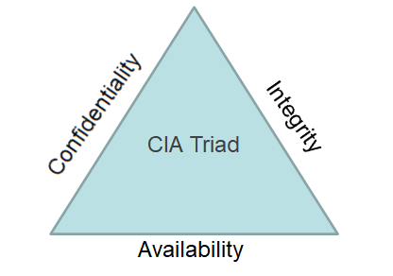
Data Security
Data security applies to stored data as well as data in transit. The CIA triad serves as the foundation for data security and is defined by the following three components:
Data Confidentiality – Ensures only authorized parties can access data
Data Integrity – Ensures that data has not been modified intentionally or unintentionally and comes from a trusted source
Data Availability – Ensures that data is accessible to users whenever needed
Data confidentiality is achieved with encryption. Data authentication and integrity is achieved with digital signatures.

Slide 13
Types of Encryption
There are two broad categories of encryption:
Symmetric Encryption
Uses a single (secret) key to encrypt and decrypt data
Both the sender and receiver must have the secret key. To deliver the key safely to the receiver, it is generated in a separate process and transmitted before communication begins.
Advanced Encryption Standard (AES) is the strongest symmetric algorithm that we have today.
Asymmetric encryption
Uses two different but mathematically related keys – public and private key
The private key is only known to the owner of the key pair and must be kept secret, but the public key can be shared freely.
Data is encrypted using the recipient’s public key and decrypted only using the private key.
For e.g., Bob wants to send a message to Alice and uses Alice’s public key to encrypt the message. Alice then uses her own private key to decrypt and read the message.
One of the most popular asymmetric algorithm is RSA (Rivest-Shamir-Adleman; named after the developers of the algorithm). It was developed in 1977 and published for commercial use.

Slide 14
Digital Signatures
Digital Signatures
A digital signature is a type of electronic signature which is used to validate the authenticity and integrity of a message such as an email, a credit card transaction, etc.
A hash function is applied to the data in the message to generate a hash value.
The sender’s private key is then used to encrypt the hash value and create the digital signature.
Receiving parties use the public key of the sender to validate the hash. If the message is tampered with, the signature is invalidated.
There are many popular hashing algorithms in use today namely, Secure Hashing Algorithm (SHA-1, SHA-2, SHA-256) and Message Digest 5 (MD5).
What is Public Key Infrastructure or PKI?
The challenge with asymmetric encryption and digital signatures is how do you verify the authenticity of the public key? How do you know that it belongs to the same entity that you think it does?
The challenge is resolved by PKI. The Certificate Authority (CA) in the PKI hierarchy is responsible for issuing, renewing, and revoking digital certificates to entities such as users, computers, applications, etc. Each digital certificate consists of a unique private and related public key pair.
A very common analogy used to explain this concept is the DMV. Just as we trust the driver’s license issued to people by the DMV, we trust the digital certificates that are issued to entities by the CA.

Slide 15
Encryption Protocols
HTTPS
Many public cloud services can be accessed over HTTPS.
The underlying protocol for HTTPS is SSL/TLS which uses encryption and authentication to accomplish security.
TLS is SSL’s successor with minor improvements.
VPN Tunnels
VPN tunnels are commonly used to securely extend an organization’s on-premise environment into the public cloud i.e., hybrid cloud .
VPN tunnels are built over the IPSec tunneling protocol.
IPSec encrypts data by using PKI certificates or asymmetric encryption, and also offers authentication.
HTTP – Hypertext Transfer Protocol Secure
SSL – Secure Sockets Layer
TLS – Transport Layer Security
VPN – Virtual Private Network
IPSec – Internet Protocol Security

Slide 16
What is Tokenization?
Tokenization is a data masking technique implemented by organizations with regulatory requirements to prevent exposure of sensitive information such as Personally Identifiable Information (PII)¹, Personal Health Information (PHI), etc.
Randomly generated “tokens” are used as placeholders for sensitive data in the public cloud.
There is no mathematical relationship between a token and the original value. Thus, tokens are useless if breached.
The process requires use of a token vault (a database) that stores the mapping between the tokens and the original value. The sensitive data remains in the vault which is secured via encryption.
¹ Example of PII include social security number, credit card number, bank account number, etc.

Slide 17
Securing Virtual Networks in the Cloud
As discussed in Chapter 4, organizations can provision a “logically isolated virtual network” in the public cloud known as Virtual Private Cloud.
Cloud customers can choose the size and IP address ranges for their VPC and customize routing based on their need.
A VPC resides in a geographic region and is further divided into trust zones via non-overlapping subnets. Subnets are of two types:
Public subnet – is used to host virtual resources that are accessible from the Internet
Private subnet – is used to host virtual resources that must be kept private
Notes:
Isolation of customer virtual networks is achieved by the CSP through Software Defined Networking or SDN.

Slide 18
Firewalls and Traffic Filters
Securing virtual networks may utilize multiple solutions:
Virtual Firewall Appliance (VFA) – performs port/service filtering and stateful packet inspection at the perimeter of the VPC
Most VFAs are next-generation and include additional functions such as:
Web Aplication Firewall (WAF)
screens traffic for web applications (Layer 7)
prevents common exploits such as cross-site scripting and SQL injection
Intrusion Detection System (IDS)/Intrusion Prevention System (IPS)
Both perform monitoring to identify malicious traffic
An IDS sends alerts and logs suspicious traffic, but an IPS can also block traffic.
DDOS Defense
Most common attack in the cloud; cloud firewalls can prevent DDOS (Distributed Denial of Service) traffic from reaching organizational cloud servers
Network ACLs (NACLs) – specify rules for what traffic is allowed in and out of subnets
Security Groups – control traffic to and from the individual virtual machines

Slide 19
Example: A Two-tier Web Application in the Cloud
A custom VPC with a private and public subnet can be utilized for the deployment of such an application. The application comprises of two tiers:
Web tier (Front end)
A virtual machine is deployed and runs web server software such as Apache.
The web server is the public-facing element that receives requests from Internet and is launched in the public subnet.
Database tier (Back end)
A virtual machine is deployed to run database software such as My SQL.
The purpose of the database is to store and retrieve client information including transactions and must be kept private.
The database VM is launched into the private subnet.
How is security built into this deployment?
Traffic from Internet users must first pass the virtual firewall appliance. The appliance will monitor and analyze incoming traffic and direct web requests to the web tier. All other traffic is blocked.
A security group is configured and attached to the web tier to permit only HTTP (port 80) or HTTPS (port 443) traffic from any source. All other traffic must be blocked.
Though traffic originating on the Internet is not permitted to reach the database server, the web server must be allowed to read/write information to the database. A second security group configuration is created specifically for the database tier to allow inbound MySQL traffic (port 3306) from the web security group. All other traffic is blocked.
A third security group can be utilized for administrators that will permit them remote access to the web and database VMs from specific IP addresses (administrator PCs) in their corporate location. RDP is commonly used with Windows VMs and SSH for Linux VMs.

Slide 20
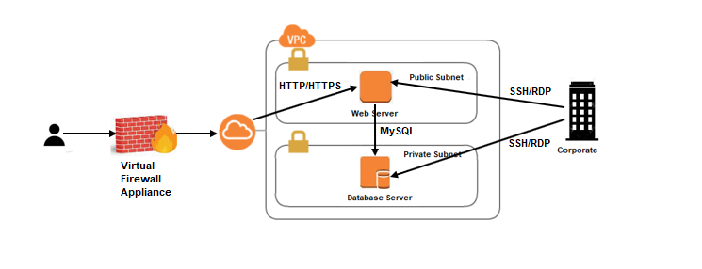
Securing a Two-tier Application in the AWS VPC

Slide 21
Identity and Access Management (IAM)
IAM is a framework that ensures that the right entities have access to the right resources when needed. It is very important for cloud customers to understand the concept of IAM as it falls under their umbrella of their responsibilities.
IAM includes the following processes:
Authentication – A process where users must prove who they are
The traditional approach includes supplying credentials in the form of a username and password.
Most organizations today however require Multi-factor authentication (MFA) for better security i.e., users must provide two or more verification factors for authentication.
There are three recognized types of factors that can be utilized:
Something You Know – For e.g., password or passphrase, PIN, code, etc.
Something You Have – For e.g., an ID card, a smart card, token, etc.
Something You Are – For e.g., fingerprint, retina scan, facial recognition, voice pattern, etc.
Authorization – A process that determines what resources authenticated users have access to
Accounting – A process that logs every user action

Slide 22
IAM - 2
There are two new terms commonly used in context of Cloud Computing:
Identity Federation or Federated Identity – When organizations adopt a public cloud, identity federation allows cloud customers to retain their on-premise credentials to access cloud services from the CSP.
Single Sign-on (SSO) – Allows users to access multiple applications through one authentication process.
The advantage is that users only need to remember one set of credentials. Examples of SSO technologies are SAML (Security Assertion Markup Language), OAuth (Open Authorization), etc.

Slide 23
Access Control Methodologies
Several methods can be used to assign permissions to users so that they can access resources. They are:
Mandatory Access Control (MAC)
Permissions to resources are controlled by the Operating System (OS)
Requires security labels or classification of data into categories such as confidential, restricted, secret, etc.
Users access resources based on their clearance level.
Discretionary Access Control (DAC)
Power to grant or deny access is at the discretion of the data owner
For e.g., access to a file is controlled through the use of an Access Control List (ACL)
Non-discretionary Access Control (NDAC)
Commonly implemented as Role-Based Access Control (RBAC)
Privileges are tied to job roles and responsibilities within the organization (for e.g., system administrator, project manager, developer, etc.)
Uses the Principle of Least Privilege (POLP)
Scales well

Slide 24
IAM Concepts and Terms in AWS
In the AWS world, permissions are governed through IAM policies which are JSON documents. AWS controls access to AWS resources and services utilizing three components:
Users – An entity such as a person, service, or application authenticated to access AWS resources
Groups – Created to assign identical permissions to multiple users. For e.g., group of developers, group of administrators, etc. This is a very scalable method. Policies are applied at the group level and automatically flow down to all the users in that group. A user can be a part of multiple groups and avail of privileges assigned to both groups.
Roles – Unlike users who are assigned long-standing credentials, roles are reserved for a temporary purpose (short-lived); roles are assumable by a person, service, or application
Click https://aws.amazon.com/iam/ for more information on AWS IAM.

Slide 25
Some Security Principles
Principle of Least Privilege (POLP) – This states that a user must be granted only the minimum permissions necessary to do their job.
Defense-in-Depth – This is a security approach that suggests the need for using multiple overlapping security controls to protect a system. For e.g., multiple trust zones alongside ACLs and intrusion detection and prevention systems would create a layered security system.
Separation of duties – A sensitive task should be performed by two or more people. This ensures that one individual cannot knowingly or unknowingly compromise a system.
Zero Trust Model – This is a security model that treats both internal and external users as “untrusted” and insists on continuous validation of access.

Slide 26
Cloud Security Best Practices
Some cloud security best practices have been discussed below. Note that this is not an exhaustive list.
Training staff
Misconfigurations are most prevalent and create security loopholes making it easy for attackers to access data and services. These happen not only from human error, but poor understanding of technology and the shared responsibility model for cloud security.
Organizations should provide CSP-specific training to their staff.
IAM solution
One of the biggest threat to cloud security is unauthorized access to resources and information. When designing an IAM solution,
Configure a strong password policy
Enable multifactor authentication (MFA) with logins to reduce risks
Assign user permissions according to the Principle of Least Privilege (POLP)
Delegate temporary credentials for short-term tasks
Enable federated access
Assume Zero Trust model for access to and between resources
Data Encryption
Enforce encryption of data at rest and transit
Leverage CSP tools for encryption and key management. For enhanced security, you may consider creating your own custom keys.

Slide 27
Cloud Security Best Practices – 2
Monitoring and Logging
Employ monitoring solutions to gain more visibility into the cloud environment.
Log user activity. Logs can help identify who performed which action, what resources were used, when did the event occur, etc.
Compliance Requirements
Organizations in healthcare, finance, etc. collect sensitive information. Others are mandated by governments to store data within specific geographical boundaries. Such organizations must make sure their cloud service provider can meet their data locality, privacy, and security needs.
Security Testing and Audit
All enterprises must conduct security testing on a regular basis to check for vulnerabilities in their cloud environment.
A periodic audit is also vital. A third-party evaluation is better as it eliminates bias from pre-existing knowledge.

Slide 28
Security Testing
Vulnerability scanning is the process of discovering flaws or weaknesses in systems and applications. Vulnerability scanning is organized into three phases: intelligent gathering, vulnerability assessment and vulnerability validation.
Penetration testing is an extension of vulnerability scanning that evaluates system security by attacking target systems as an outside attacker would, and documenting which attacks were successful, how the systems were exploited, and which vulnerabilities were utilized.
Penetration testing is organized into seven phases: intelligent gathering, vulnerability assessment and vulnerability validation, attack planning and simulation, exploitation, post-exploitation and reporting.
Some cloud vendors may require notification before conducting vulnerability scanning or penetration testing.
Notes:
Vulnerability assessment identifies weaknesses without running a penetration test.

